Slide 1
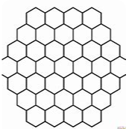
Hexagonal Polygon Mesh

